Slide 1
Certification Exam Rapid Training AZ-104 Azure Administrator
aka.ms/az-104
aka.ms/CERT/YouTube

Slide 2

Exam AZ-104 Objectives

Slide 3
Manage Azure Identities and Governance 15-20%
Manage Azure Azure AD Objects
Manage Role Based Access Control (RBAC)
Manage Subscriptions and Governance

Slide 4
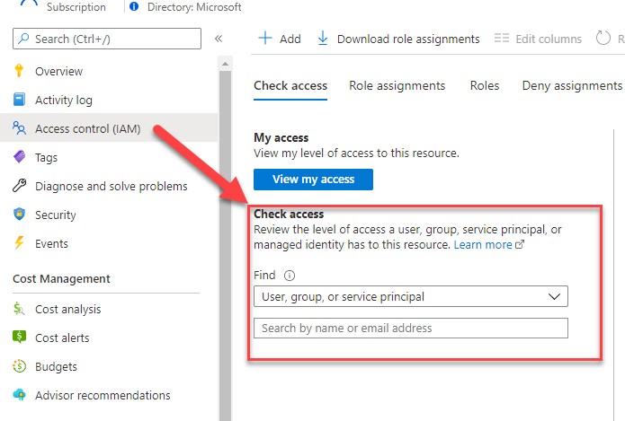
Interpret Access Assignments
Check Access feature!
Azure Role Assignments
Azure Deny Assignments

Slide 5
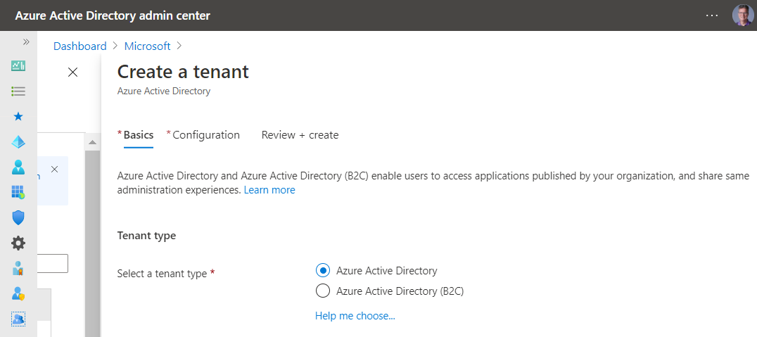
Manage Multiple Tenants/Directories
Resource independence
Administrative independence
Synchronization independence
https://aad.portal.azure.com/
https://docs.microsoft.com/en-us/azure/active-directory/enterprise-users/licensing-directory-independence

Slide 6
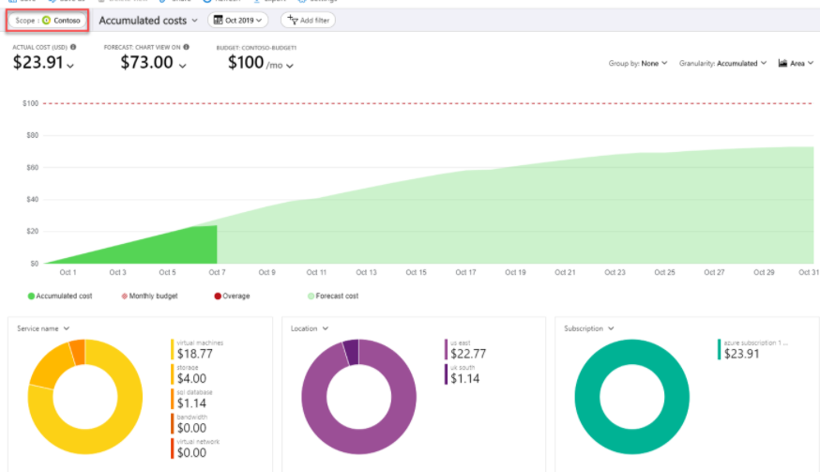

Configure Cost Management
Scopes
Group & Filter properties
Tag em
Use Cost Analysis

Slide 7
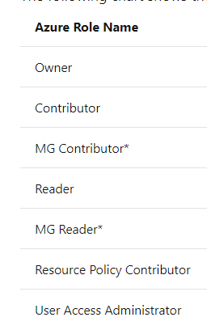
Configure Management Groups
Understand the Root Management Group
Initial Setup
Management Group Access
Custom Role definition and assignment
Move them!
Audit them!
https://docs.microsoft.com/en-us/azure/governance/management-groups/overview#initial-setup-of-management-groups

Slide 8
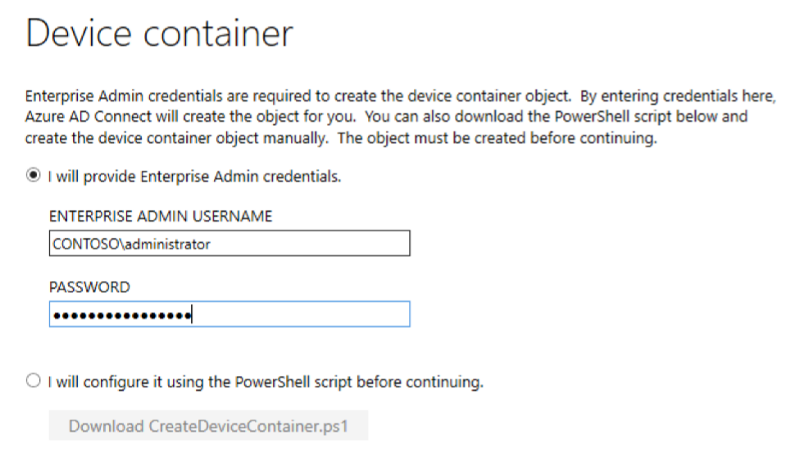
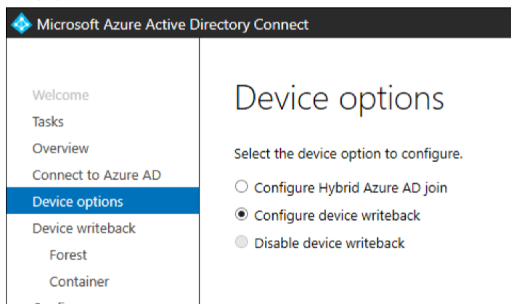
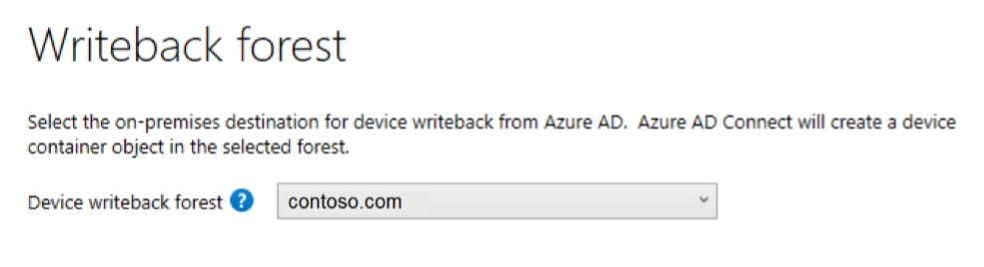
Manage password sync and writeback
Writeback Features
Additional Security to Trusted Devices
Single Forest only
FFDL 2012 R2 or higher
Azure AD Premium required
Azure AD Connect drive it
Writeback Scenarios
Windows Hello for Business using hybrid certificate trust deployment
Enable Conditional Access based on devices to ADFS (2012 R2 or higher) protected applications (relying party trusts).

Slide 9
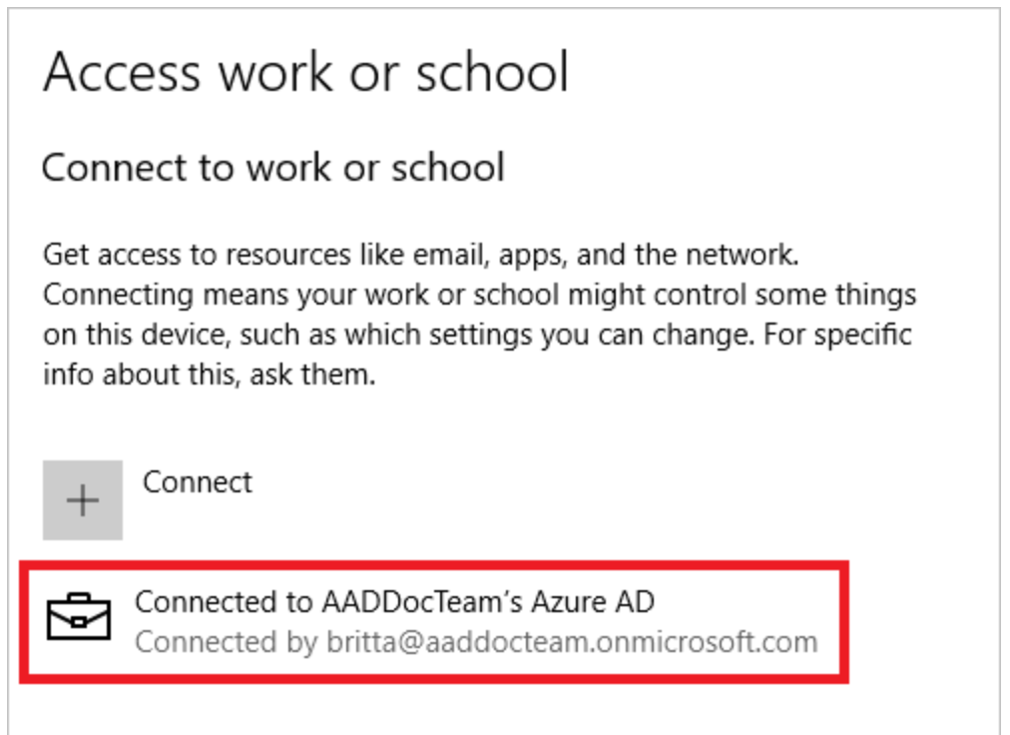
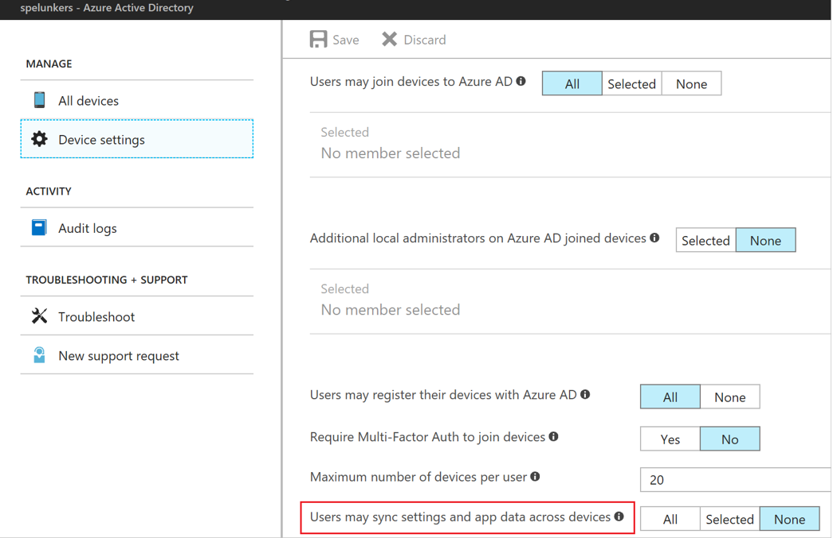
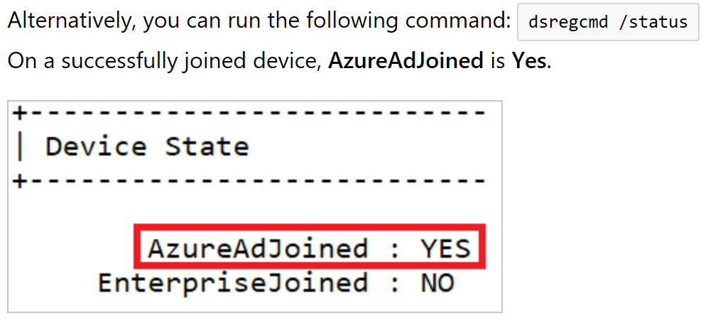
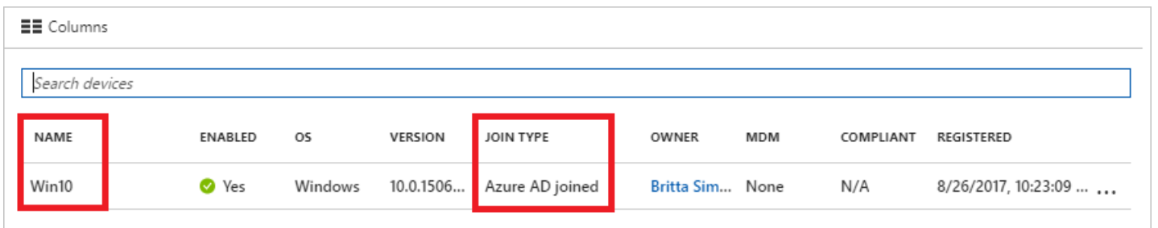
Manage Azure Active Directory (AD) Azure AD Join
aka.ms/Azure/Roaming
Requires
Azure AD + Subscription
Windows 10 (Pro/Ent)
Admin Tasks
See picture ->
User Tasks
Register Windows 10 Device – BYOD
Join Corp Device
Settings, Account, Access Work or School
Verify

Slide 10
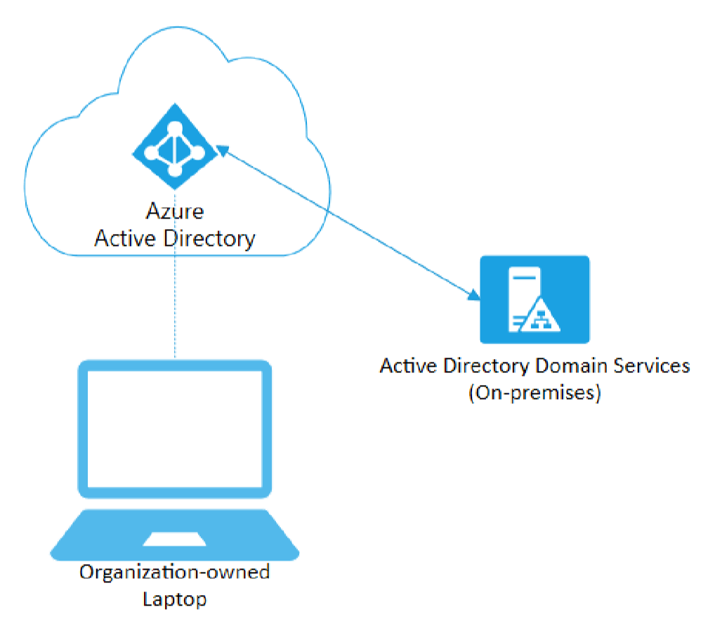
Azure AD Join
Capabilities
AuthN to Azure AD
Conditional Access Policies
Can Secure with MDM
Intune or SCCM
Can Still AuthN On-Prem
Self Service
OOBE
Bulk Enrollment
Windows Autopilot

Slide 11
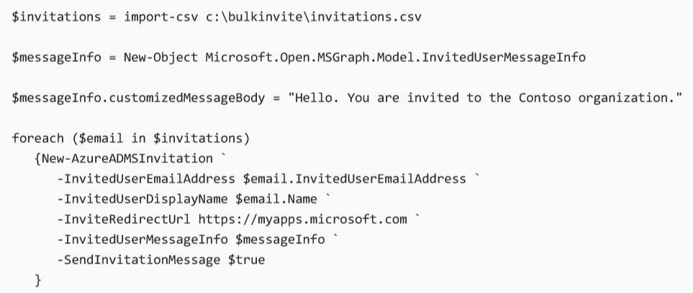
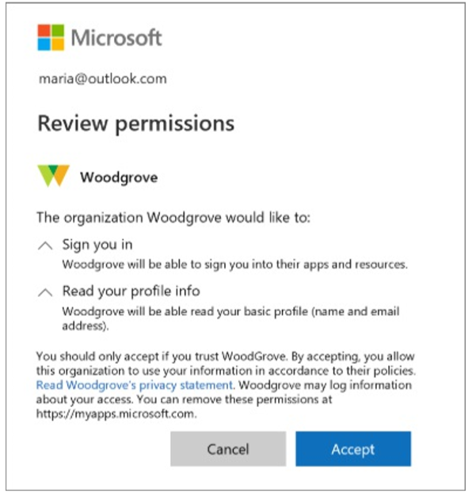
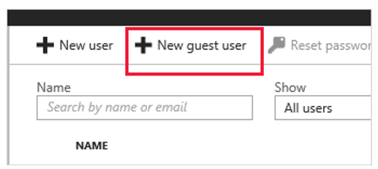
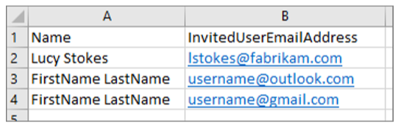
Manage Guest User Accounts
Features
Partners use their own identities
Azure AD NOT required
No management of external accounts
No need to Sync Accounts
Sign in with Work, School or social identities
Apply Conditional Access Policies
Invitation Process
Add users in the Portal
Bulk invite with CSV
Invitations.csv
Add with PowerShell
New-AzureADMSInvitation

Slide 12
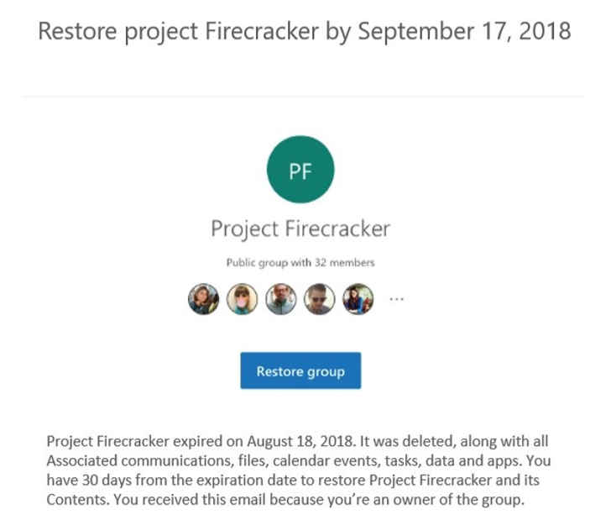
Dynamic Group Membership
Features
Add users to
Security Groups
Office 365 Groups
Change of User or Device properties
Requirements
1 Azure AD Premium license
For Global Admin
Not required to assign users
Other points
Deletion and recreate - > 24 hours
Group Expires 1 day after notification
Can be restored within 30 days

Slide 13
Subscription Governance
configure Azure policies
configure resource locks
apply tags
create and manage resource groups o move resources o remove RGs
manage subscriptions
configure Cost Management
configure management groups

Slide 14
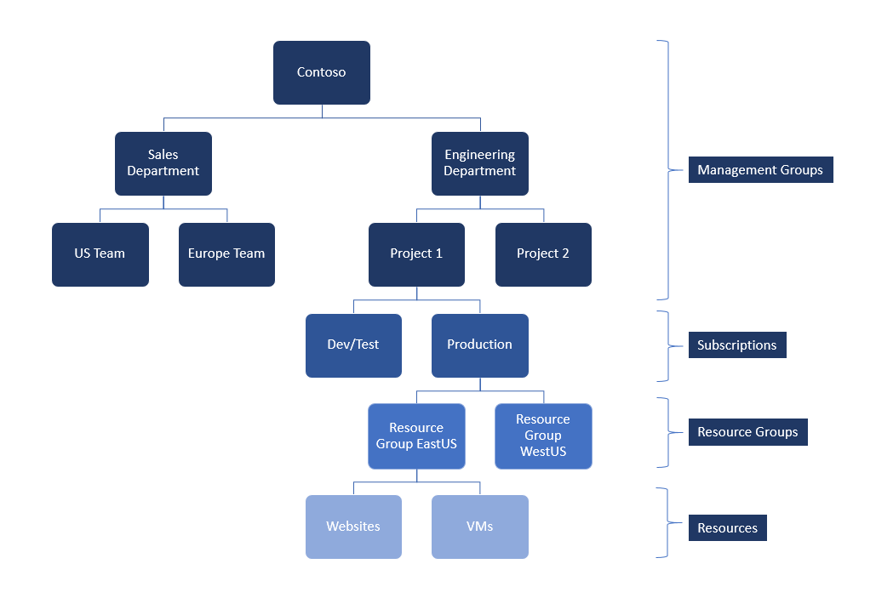
Azure Management Groups
Private Preview
Purpose
Organize Multiple Azure subscriptions
Manage
Access
Policy
Costs
Compliance
Trust with Azure AD
Trust a single Azure AD Tenant
NOTE: Policies are NOT enforced across Azure AD Directory tenants
aka.ms/Azure/MgtGroups
Check link for current status

Slide 15
Manage Resource Groups | Move Resources
Checklist:
Common Azure AD Tenant
If not the same
Transfer Ownership
Associate or add an Azure Subscription
Common Resource Providers
Quotas Exceeded?
Minimum Permissions
Microsoft.Resources/subscriptions/resourceGroups/moveResources/action on the source resource group.
Microsoft.Resources/subscriptions/resourceGroups/write on the destination resource group.
Limit of 800 moves, possible timeouts

Slide 16
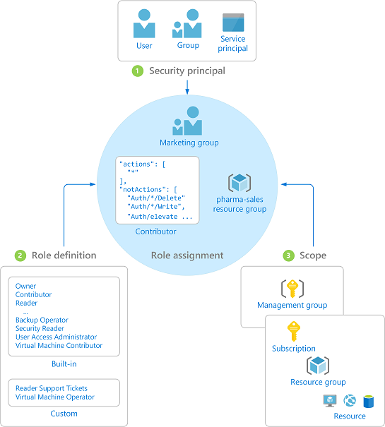
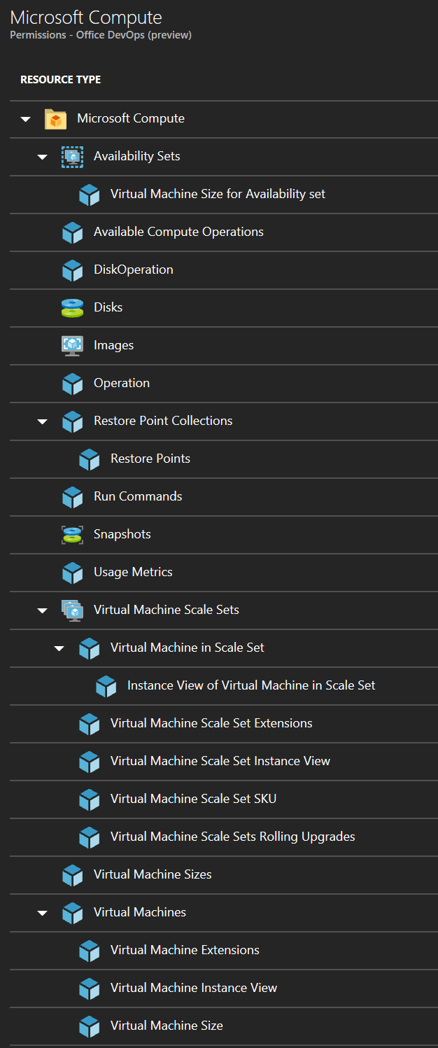
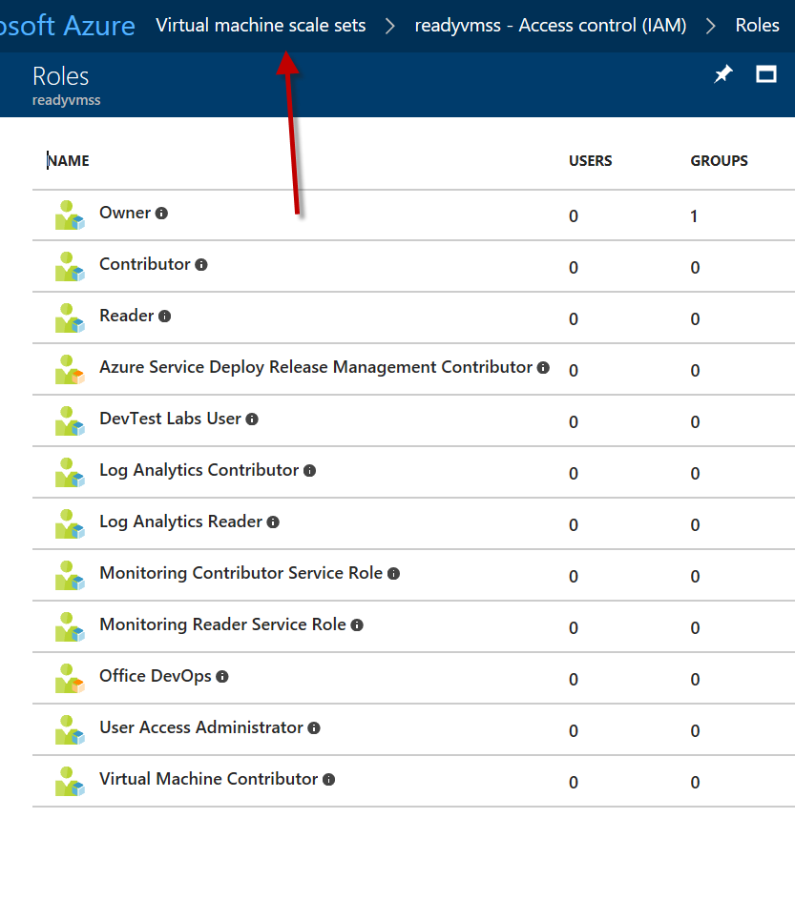
Manage Azure Subscriptions Administrator Permissions
aka.ms/Azure/Subscriptions aka.ms/Azure/RBAC

Slide 17
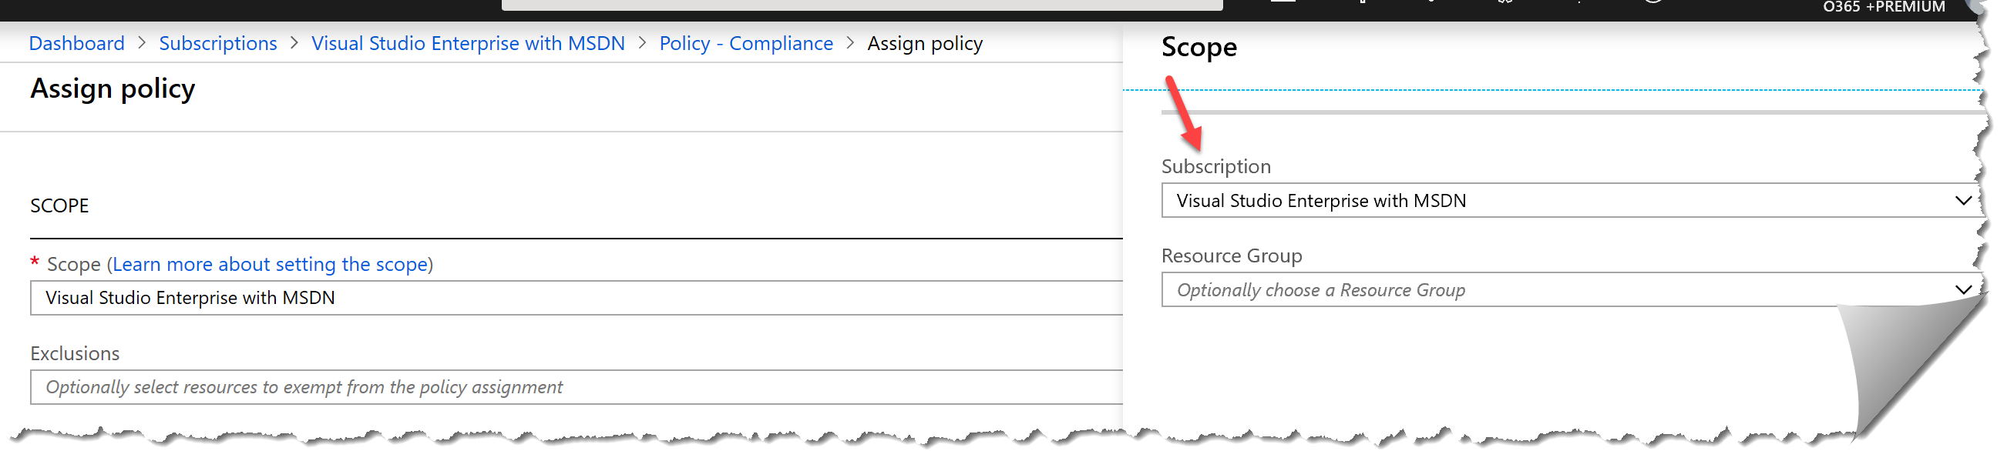
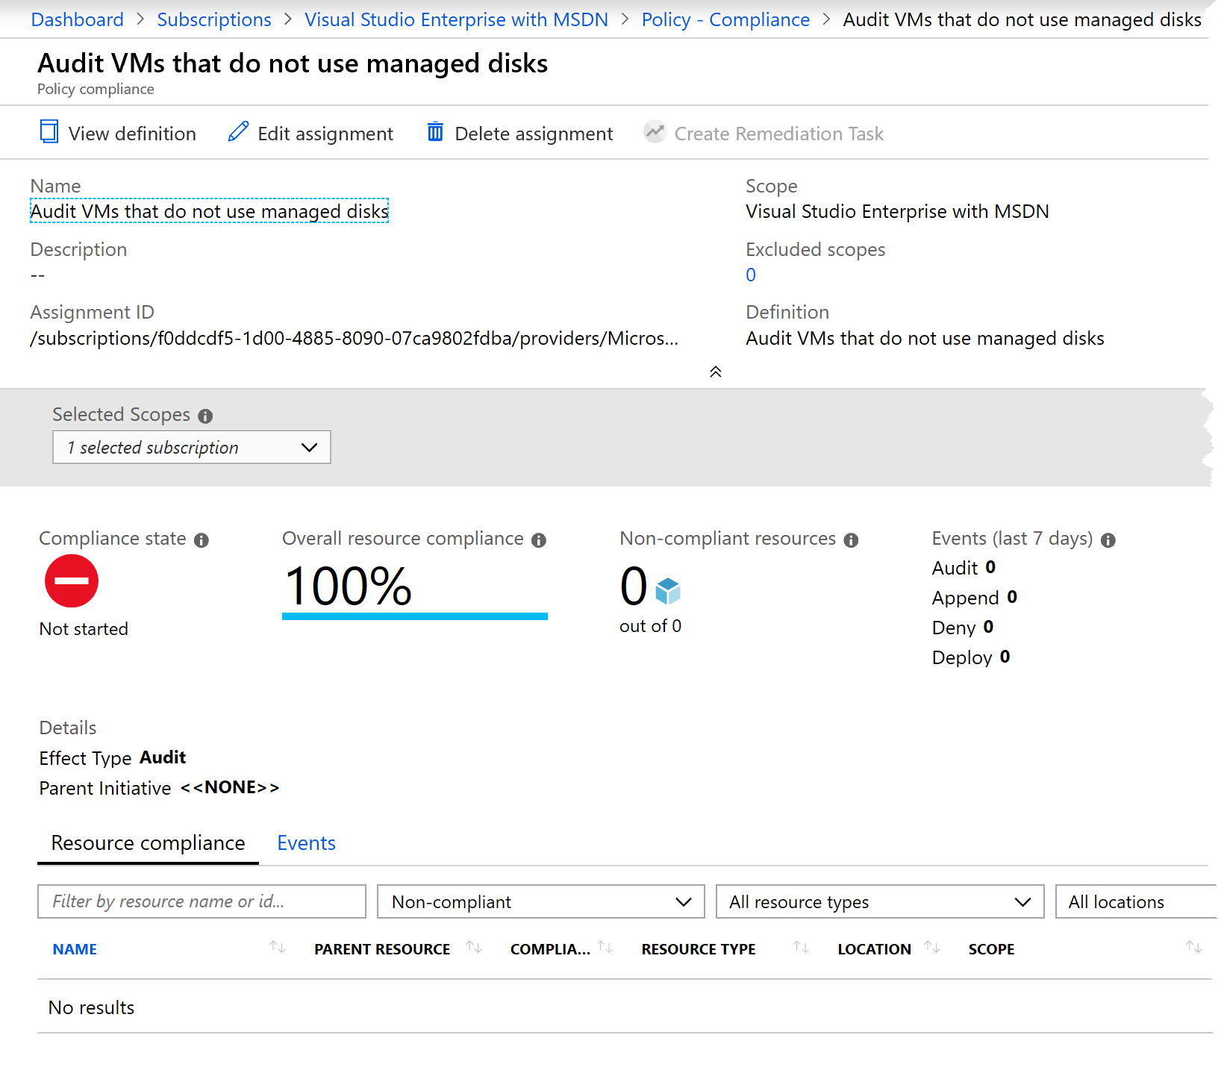
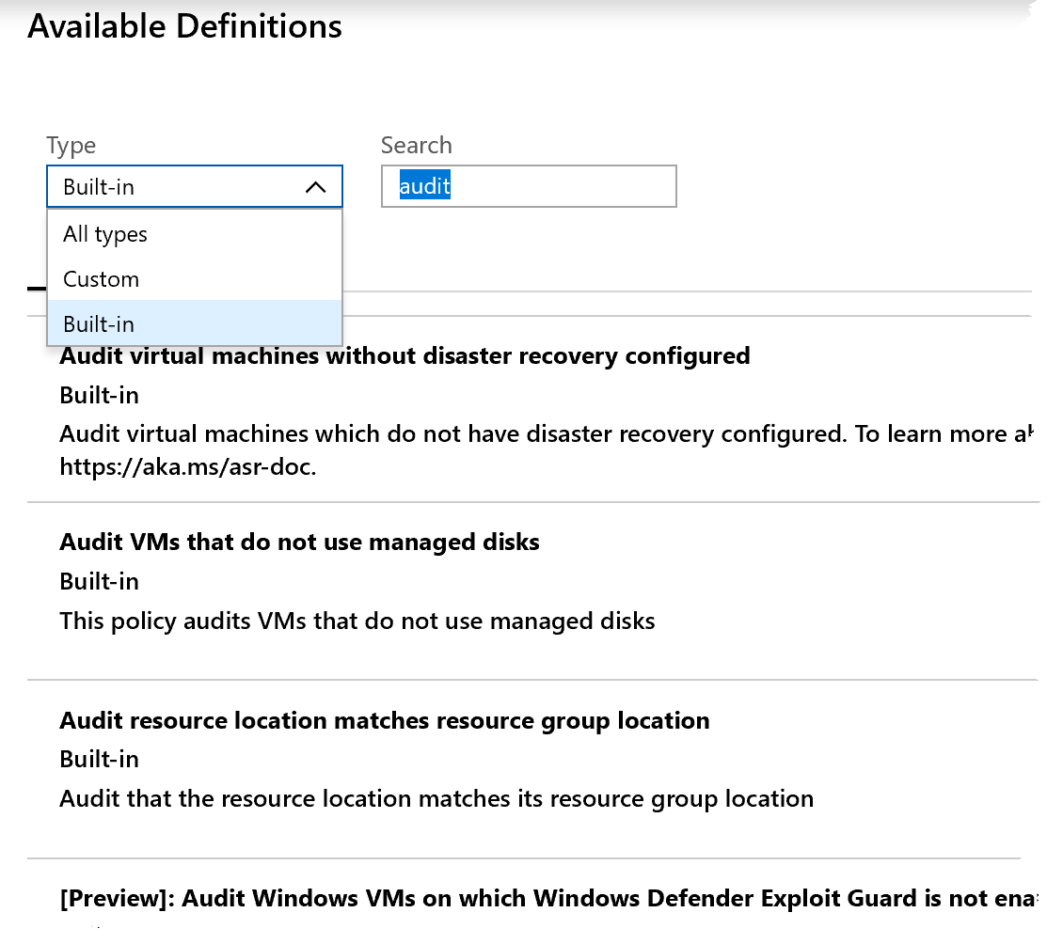
Azure Policies| At Subscription Scope
Select your Scope
Exclusions?
Resource Groups
Filter Definitions by Types /Search
All
Custom
Built-in
Managed Identities? – location
Read Azure Policies

Slide 18
Useful Azure Resource Manager Commands
az group update --name prod –rg --set tags.Dept=IT
az resource tag --tags Dept=IT Environment=Test -g examplegroup -n examplevnet --resource-type "Microsoft.Network/virtualNetworks"
az resource tag
az policy assignment
az tag add-value
az group show -n examplegroup --query tags
az resource show -n examplevnet -g examplegroup --resource-type "Microsoft.Network/virtualNetworks" --query tags
Set-AzResourceGroup -Tag @{} -Name examplegroup
Use tags to organize your resources
Manage Azure using PowerShell
Manage Azure using CLI

Slide 19
Enable MFA for an Azure Tenant
Just Read This Doc!

Slide 20
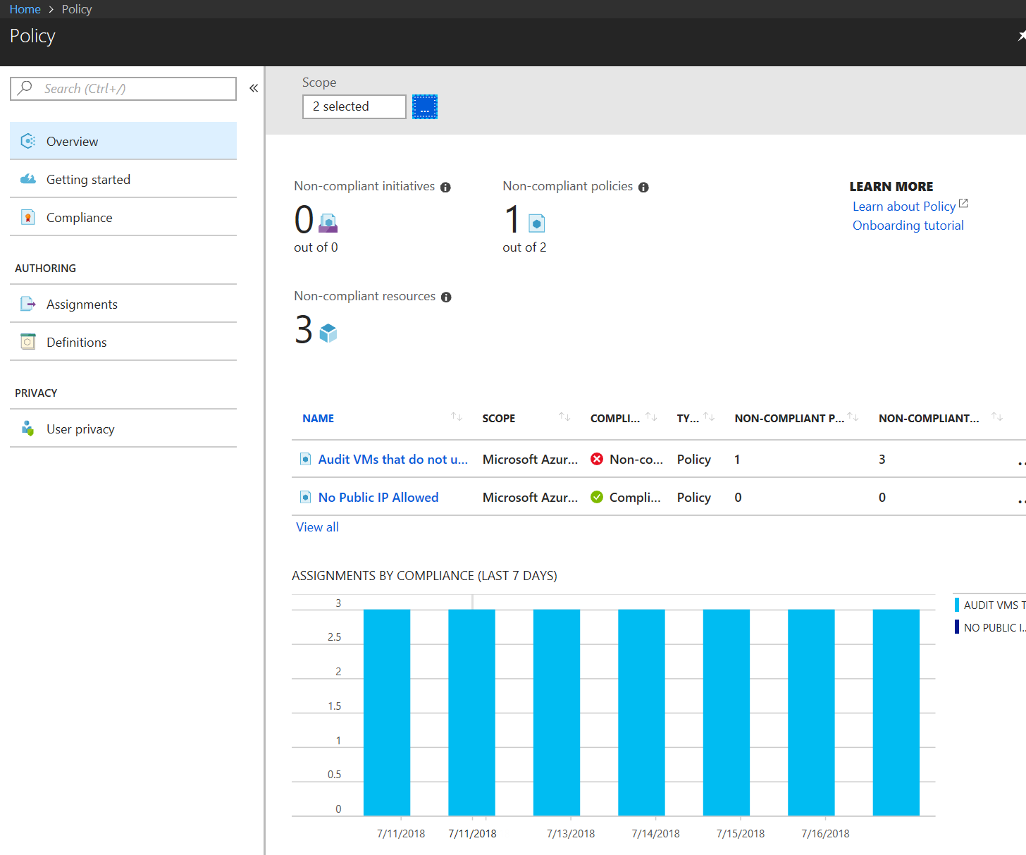
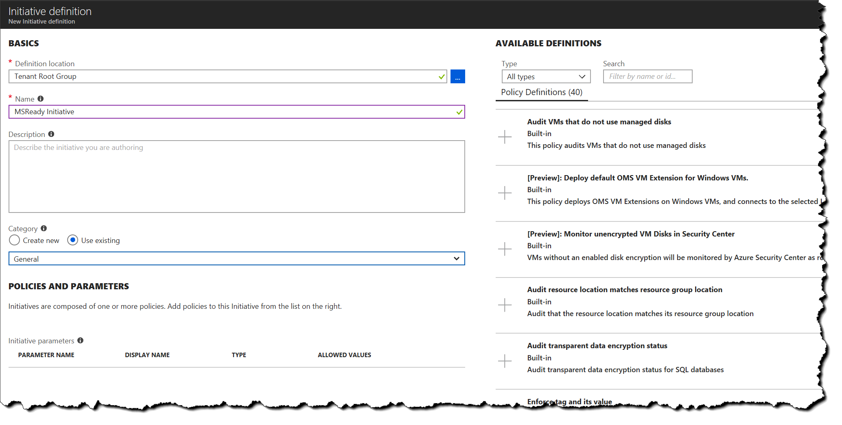
Manage Role-Based Access Control (RBAC) Implement RBAC policies
Now in the Portal!
Write Policy Definitions
Assign a Policy
Assign an Initiative
View Results, check compliance
Make exclusions by scope
Watch a Video How to
aka.ms/Azure/Policies

Slide 21
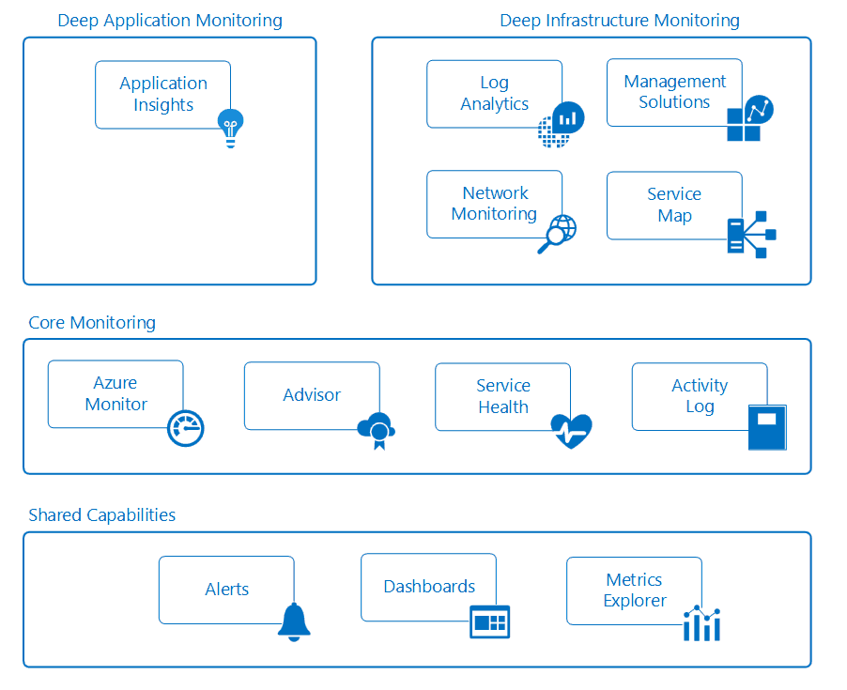
Analyze Resource Utilization and Consumption
https://docs.microsoft.com/en-us/azure/monitoring-and-diagnostics/monitoring-overview

Slide 22
Implement & Manage Storage 10-15%
Manage Storage Accounts
Manage Data in Azure Storage
Configure Azure Files and Azure Blob Storage

Slide 23
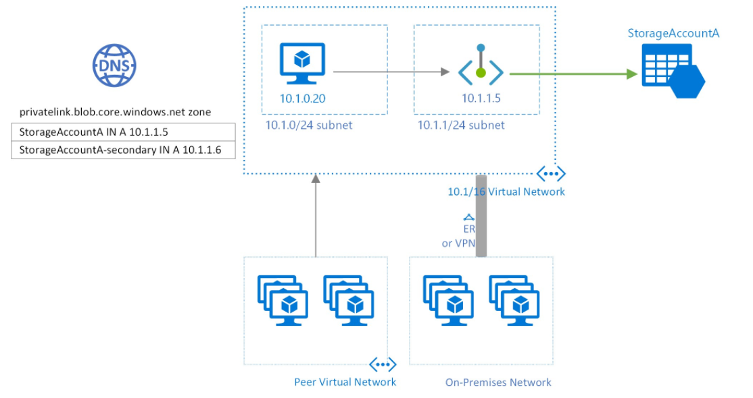
Configure Network Access to Storage Accounts
Require secure transfer
Use Private Endpoints
Configure firewalls and virtual networks
Manage TLS

Slide 24
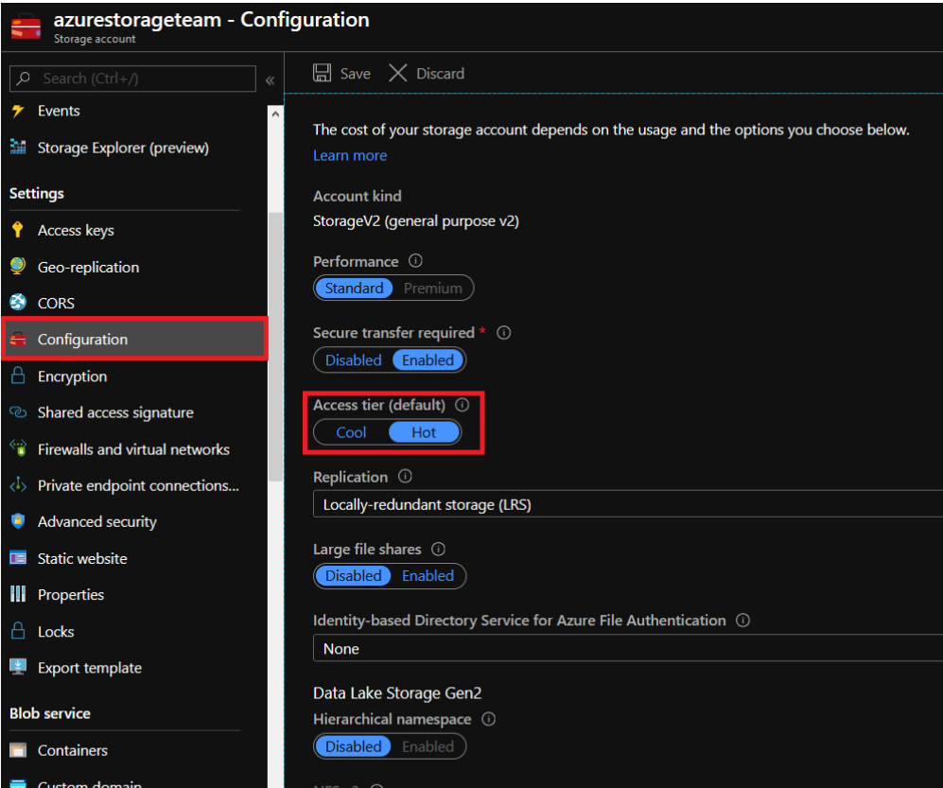
Configure Storage Tiers for Azure blobs
Available Access Tiers
Considerations
Support
Automate access tiers lifecycle
https://docs.microsoft.com/en-us/azure/storage/blobs/storage-blob-storage-tiers

Slide 25
Create Azure File Sync Service
Need Azure File Share - prereq
Prepare Windows Server
Deploy the Storage Sync Service
Install the Azure File Sync Agent
Register Server with Service
Create an Azure Sync Group - read
Create Server Endpoint
Deploy Azure File Sync

Slide 26
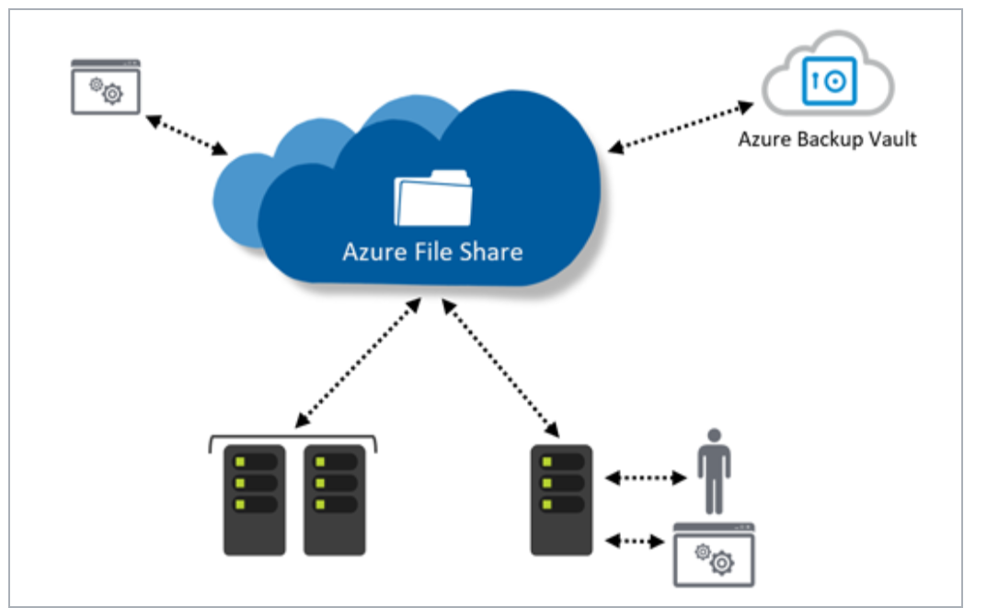
Configure Azure Files | Azure File Sync
Azure File Sync Service
Supported on
Windows Server 2012R2/16
NTFS Volumes/Compression
DFS with 1.2 Agent
Bitlocker, AIP, AAD RMS,
NOT supported
Other file systems period
Sysprep
NTFS EFS
No Other HSM
Azure Sync Group
Defines Sync Topology for set of files
aka.ms/azure/files Deploy Azure File Sync

Slide 27
Data Transfer Services
Choose Solution
Shippable Devices
Data Box Disk | 100GB -50TB
Data Box | 50-500TB
Data Box Heavy | 500TB+
Network Transfer
Storage Explorer
Scripted e.g. AZCOPY
Azure DataFactory - pipeline
Read Selecting a Data Transfer Solution

Slide 28
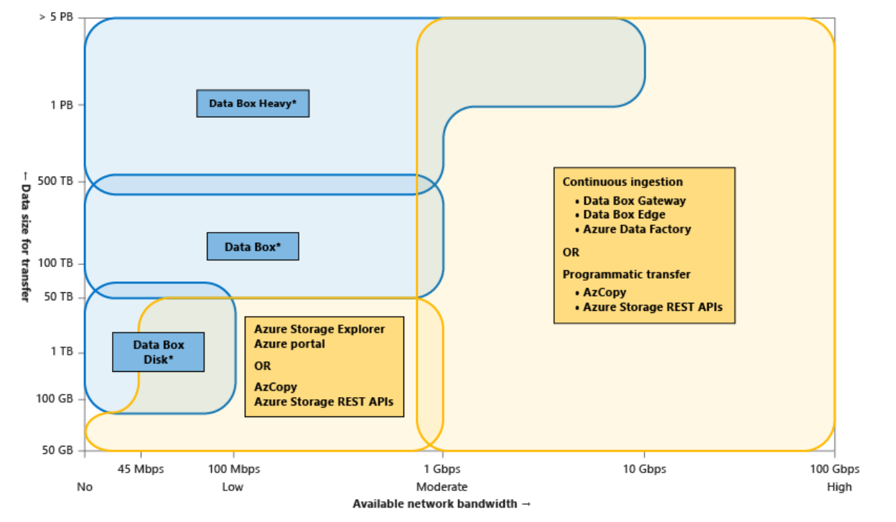
Choose Solution
Read Selecting a Data Transfer Solution

Slide 29
Import and Export Data to Azure
aka.ms/Azure/ImportExport
Azure Blob to disk drives
Ship drives to Azure
bitlockered
Or from blobs to on-premises disks
Use Cases
Data migration to the cloud
Content distribution
Backup
Data recovery
WAImportExport tool – cmd
V1 - use for blob storage
V2 – use for into Azure Files
WAImportExport
Repair an Export Job
/r
/d
/sn
/sk
/CopylogFile:C:\WAImportExport\DriverID.log

Slide 30
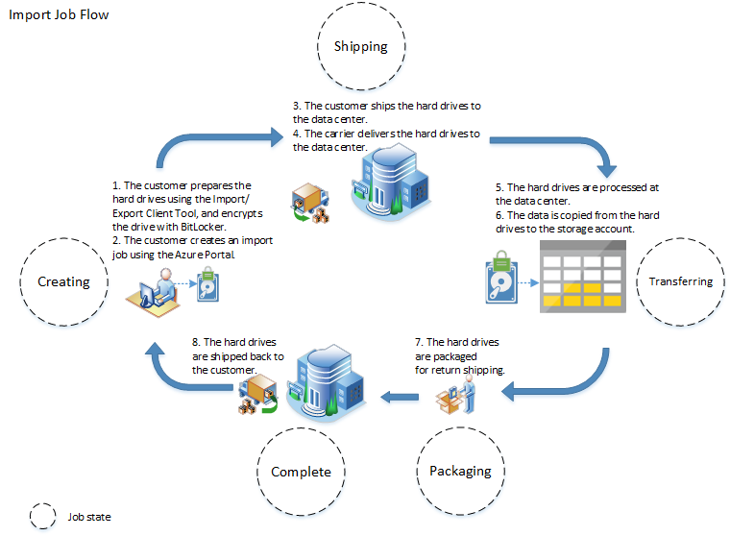
Import Job Flow
aka.ms/azureimportexport

Slide 31
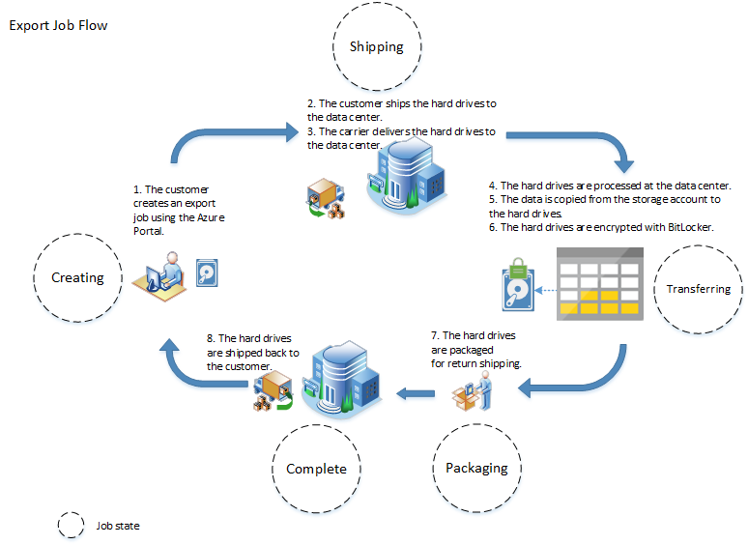
Export Job Flow
aka.ms/azureimportexport

Slide 32
Use Azure Data Box
docs.microsoft.com/azure/databox/
Order
Return
Upload
Receive
Copy Data
Prerequisites
Storage Account
EA, CSP or Azure Sponsorship
Subscription Owner or Contributor access
Via
SMB
NFS
REST
VHDs copied as page blobs, uploaded as managed disks
Uploaded to
Blobs in Storage Account
Managed Disks’ RG

Slide 33
Troubleshoot Azure File Sync
Error messages
Agent installation fails on Active Directory Domain Controller
When I register a server, I see numerous "web site not trusted" responses. – Why?
Cloud endpoint creation fails, with this error: "AuthorizationFailed“
Server endpoint creation fails, with this error: "MgmtServerJobFailed" (Error code: -2134375898)
Server endpoint deletion fails, with this error: "MgmtServerJobExpired“
Unable to open server endpoint properties page or update cloud tiering policy
Troubleshoot Azure File Sync

Slide 34
Deploy & Manage Azure Compute Resources 25-30%
Configure VMs for high availability and scalability
Automate deployment and configuration of VMs
Create and configure VMs
Create and configure containers
Create and configure Web Apps

Slide 35
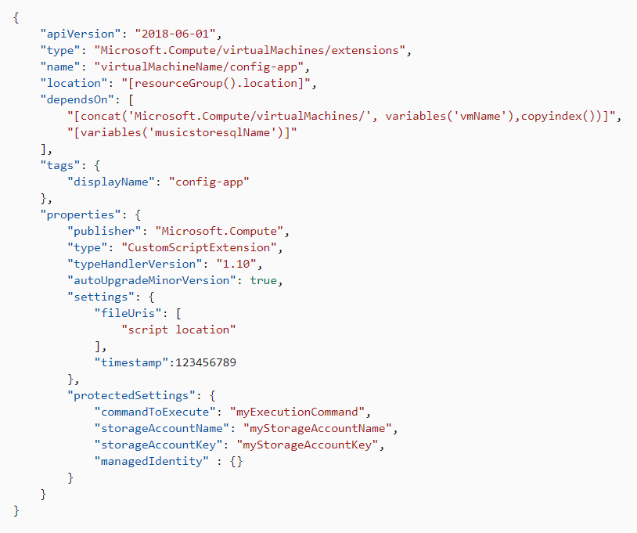
Using Custom Script Extensions
Know the Tips and Tricks!
Extension Schema
Property Values
commandToExecute
See the tutorial
https://docs.microsoft.com/en-us/azure/virtual-machines/extensions/custom-script-windows

Slide 36
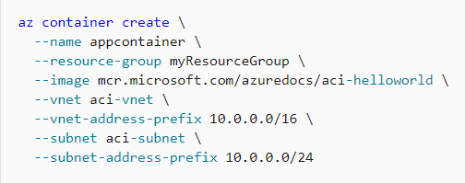
Create and Configure Azure Container Instances
Deploy into a Virtual Network
Manage Running Containers
Liveness probe
Readiness probes
Start & Stop
Update
https://docs.microsoft.com/en-us/azure/container-instances/container-instances-overview or
download the docs!

Slide 37
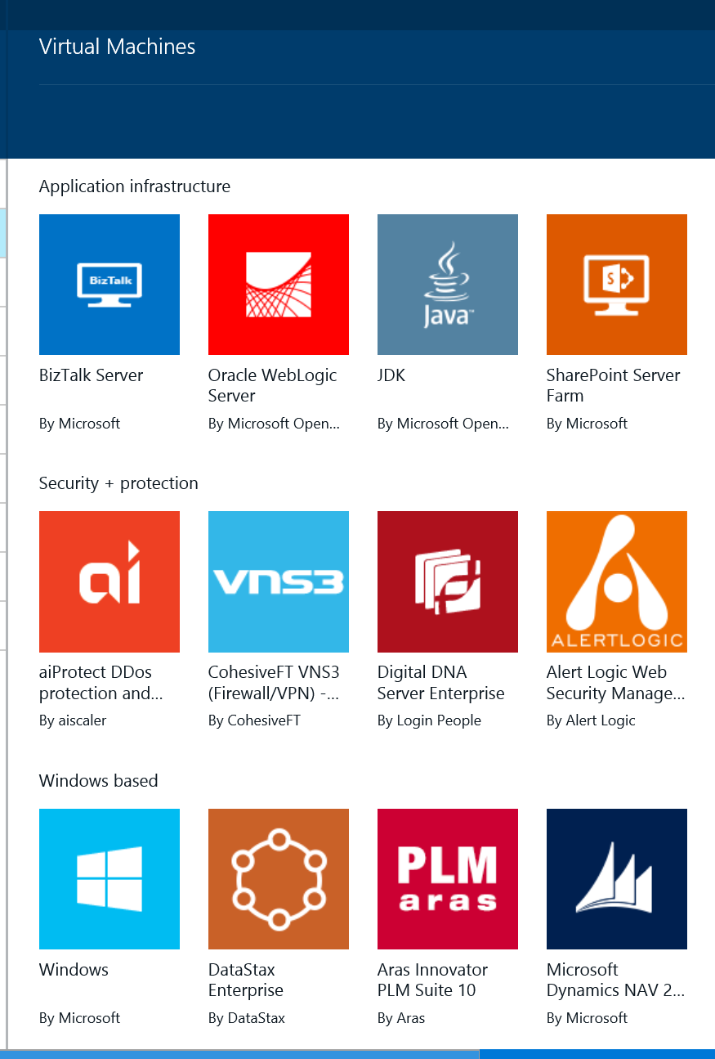
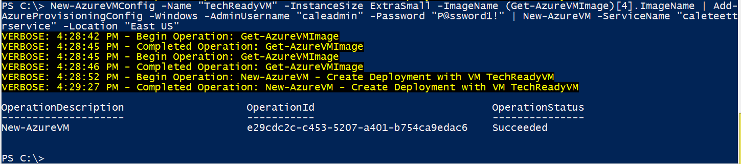
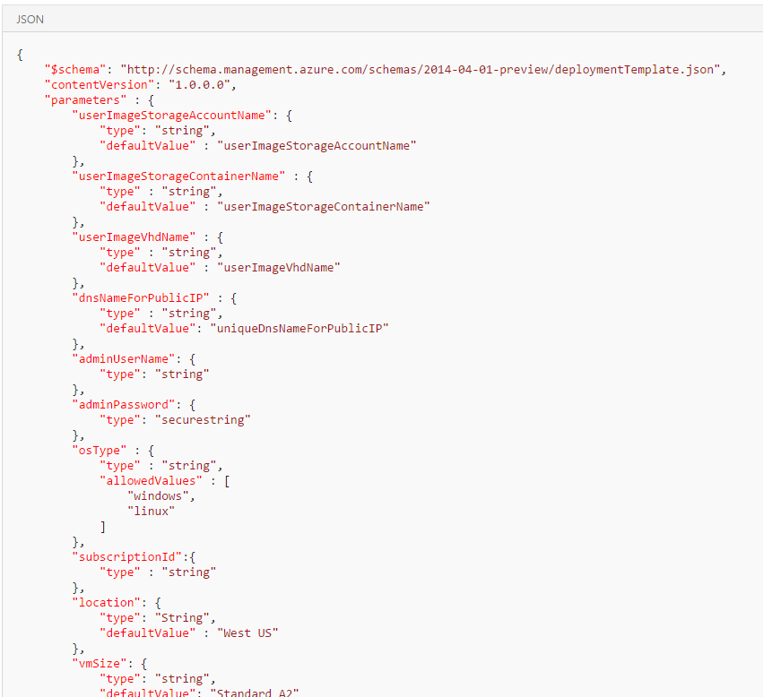
Automate Deployment of VMs
Deployment options
Marketplace
PowerShell
Azure CLI
ARM Template
Portal
Code (C#/Java/Python)
Different ways to create a VM

Slide 38
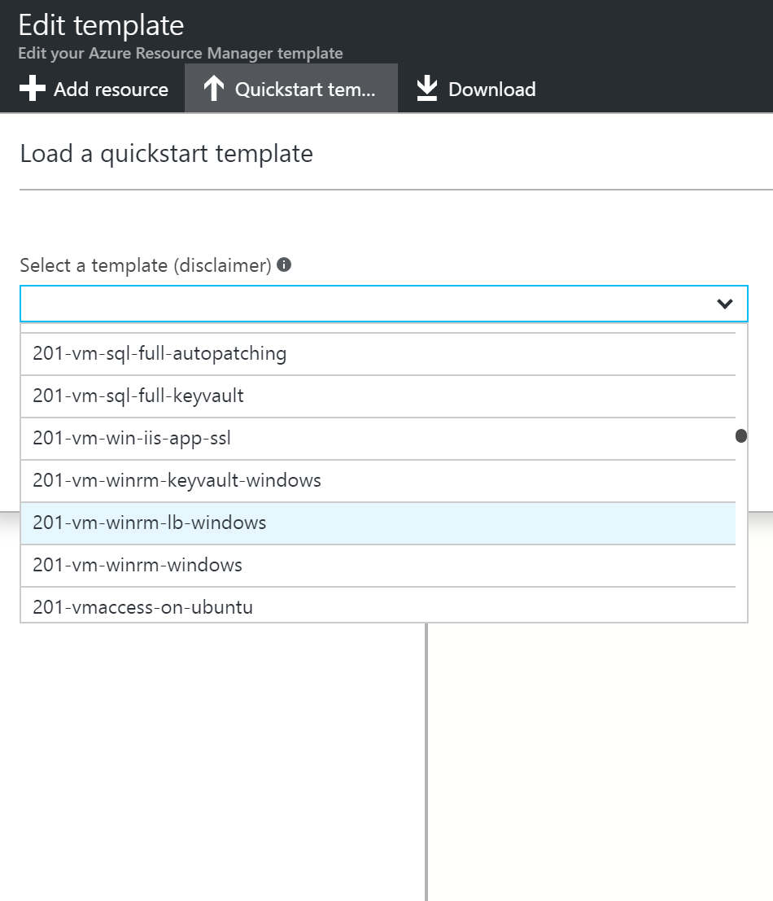
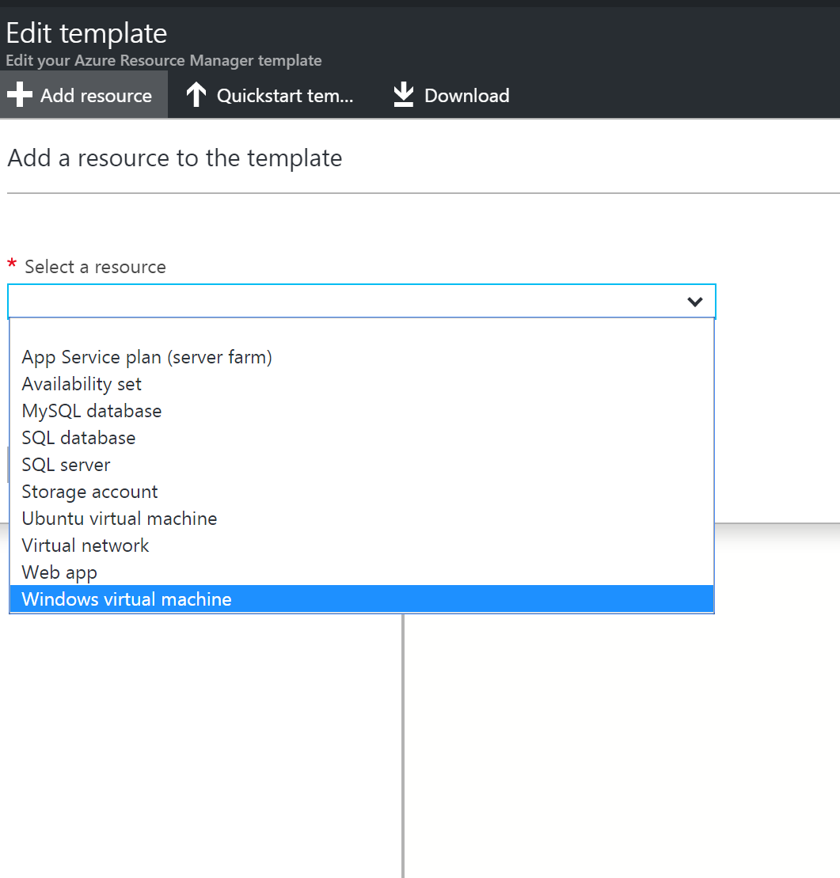
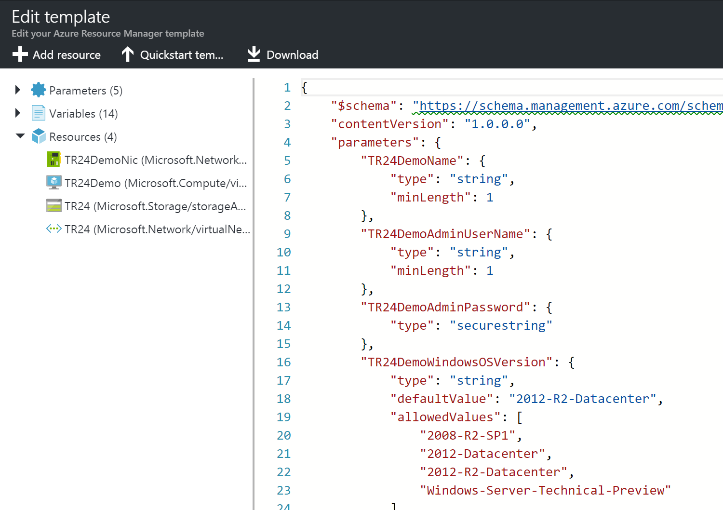
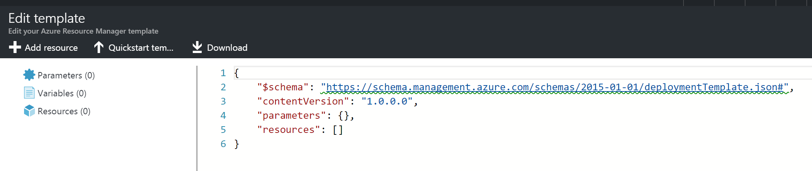
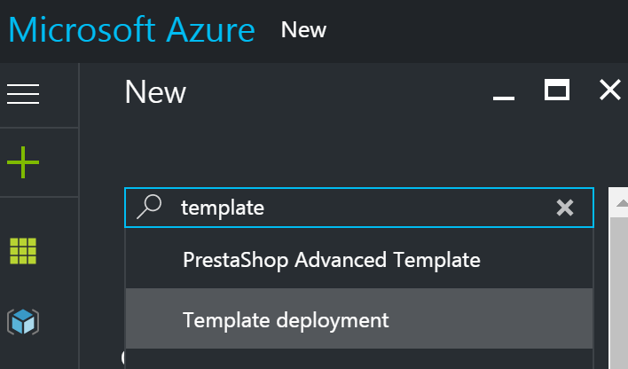
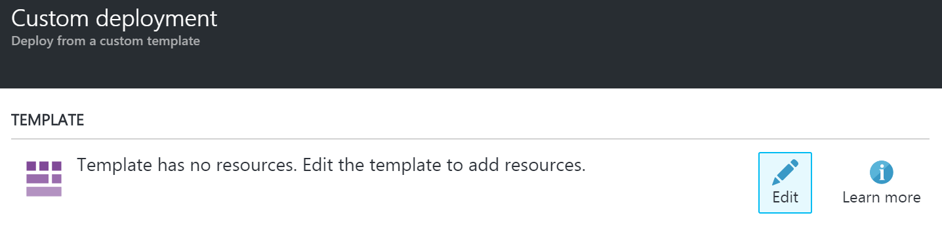
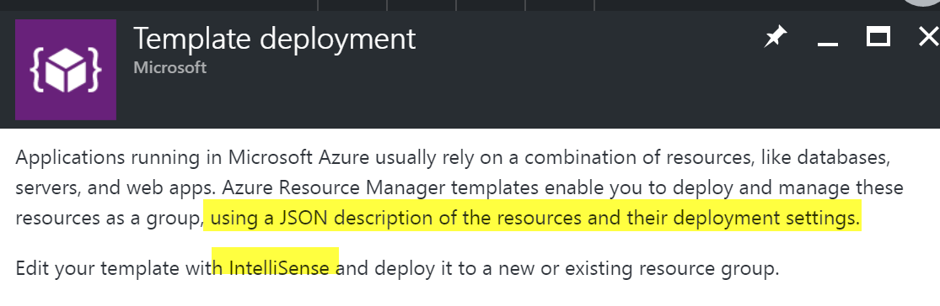
Automate Deployment of VMs ARM Templates
ARM Template Walkthrough

Slide 39
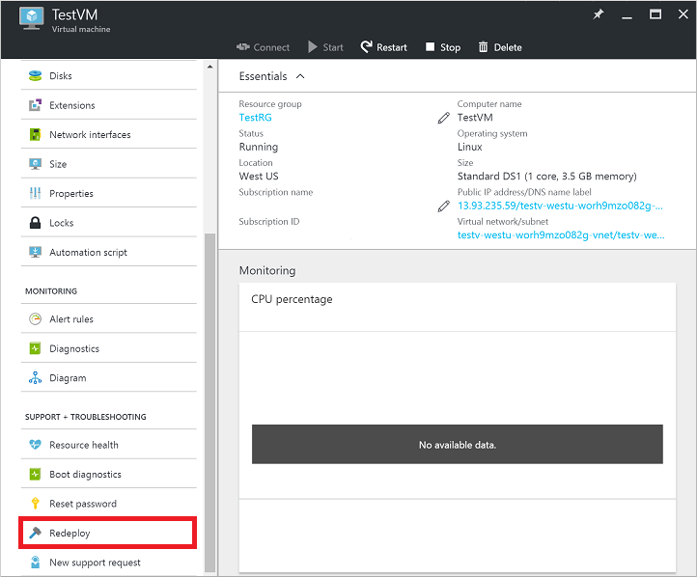
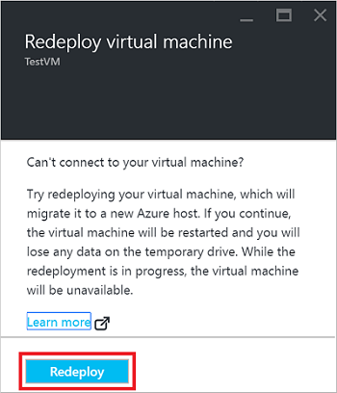
Manage Azure VM | redeploy VM
Methods
Azure Portal
PowerShell
Azure CLI 1.0/2.0
az vm redeploy --resource-group myResourceGroup --name myVM
azure vm redeploy --resource-group myResourceGroup --vm-name myVM

Slide 40
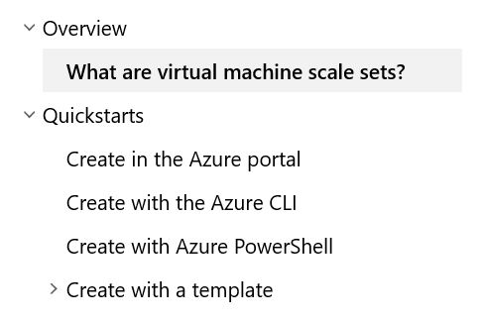
Deploy and Configure Scale Sets
Deploy
Visual Studio
Availability Zones
Placement Groups
Zone Balancing
Autoscale
Applications, Extensions, Data Disks, Encrypt disks
Configure
Modify Scale Set
Know Restrictions
When Deallocation required
See Scenarios
See Checklist for using Large Scale Sets!
Read VMSS w/ Availability Zones
Click the link

Slide 41
Deploy & Manage Virtual Networks 30-35%
aka.ms/VNetFAQ
Implement and manage virtual networking
Configure name resolution
Secure Access to Virtual Networks
Configure Load Balancing
Monitor and troubleshoot virtual networking
Integrate on premises network with Azure Virtual Network

Slide 42
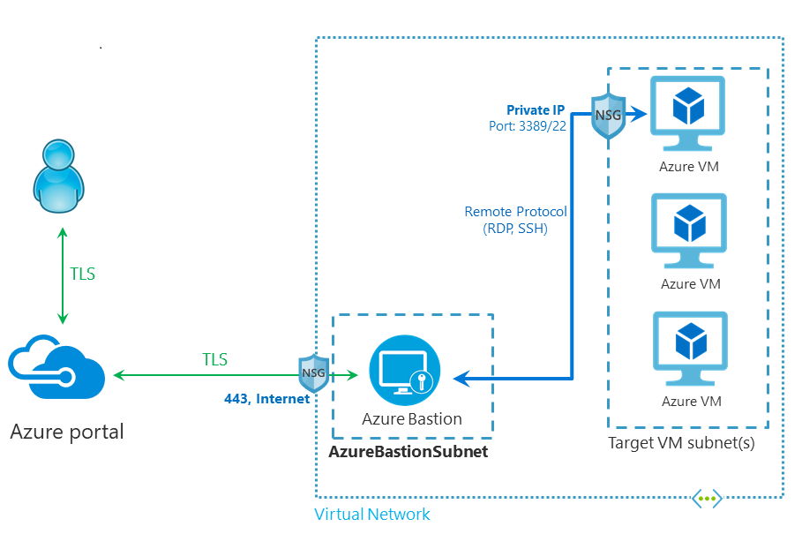
Deploy and Configure Azure Bastion Service
Deploy
Do the Tutorial!
Read the FAQ!
Configure
NSG Access
Resource Logs
Monitor / Manage

Slide 43
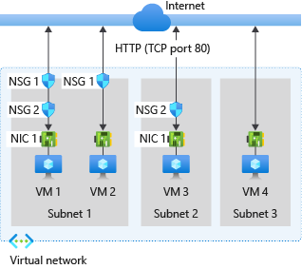
Evaluate Effective Security Rules
Know how traffic is evaluated
Inbound / Outbound
Intra Subnet traffic
Use Network Watcher
IP Flow Verify
Quickstart to try it!
https://docs.microsoft.com/en-us/azure/virtual-network/network-security-group-how-it-works
https://docs.microsoft.com/en-us/azure/network-watcher/network-watcher-security-group-view-overview

Slide 44

Configure Express Route
Create a Circuit
Create and Modify Peering
Virtual Network Gateway
Connect Vnet to Circuit
Route Filters

Slide 45

Troubleshoot External Networking
Network Adapter
Network Security Group Settings
Connectivity Check
IP Flow Verify
Download the Azure Networking PDF!

Slide 46

Configure Application Gateway
Front End IP Address
Listeners
Request Routing Rules
HTTP Settings
Back End Pool
Health Probes
https://docs.microsoft.com/en-us/azure/application-gateway/configuration-overview

Slide 47

Configure Azure Virtual WAN
Site to Site
Custom IPSec Policy
User VPN
ExpressRoute
Encryption

Slide 48






The Big Picture | Segmentation & Isolation
Shared Services
PaaS Spoke 1
DDOS Protection
DDOS Protection
PIP
PIP
AppService subnet
NSG
Gateway subnet
WAF: HTTP/s ingress
Egress
Ingress (non-http/s) Spoke-Spoke
Spoke-On-Prem
Azure Key Vault
AD DS
Web server
Client
ExpressRoute
NSG
App Service
Firewall
ER Gateway
Application Gateway
Azure firewall
SQLDB
Spoke1 VNet
DNS
Client
On-prem system
DevOps
On-premises
Iaas Spoke2
Shared services subnet
N-tier subnet
Cloud native Security Services DDoS Protection for Public IPs
App GW WAF—Web Application Protection Azure Firewall—Full egress and ingress (non-http/s) controls
NSG—Internal VNET segmentation
Service Endpoints—Secure access to PaaS
NSG
NSG
SysOps
Bastion host
ADDS1
ADDS2
SQL1
Vnet Service Endpoint
Azure Key Vault
Hub virtual network
Web servers
Web API
SQL2
Vnet Service Endpoint
Cloud witness
SecOps
Spoke2 VNet
NetOps
Azure Management
Security Center
Azure Active Directory
Azure Key Vault
DevOps

Slide 49


Create Connectivity Between Virtual Networks Create and configure VNET peering
Benefits
Connect 2 VNets in same region
Routed through Azure Backbone
Requirements
Same Region & Across Regions
Read-Write to VNet
Non-overlapping IP Addresses
No Transitivity
Across Subscriptions possible with common tenant
Capabilities
Open or Close NSGs
Internal DNS only within VNet, no Azure DNS across
Service Chaining | Next Hop with UDR or Hub-Spoke
See Constraints!!!
aka.ms/Azure/Peering Just Do It!

Slide 50

Load Balancing
aka.ms/LoadBalancing
Basic
Visual Studio
Availability Zones
Placement Groups
Standard
Modify Scale Set
Know Restrictions
Steps
Create LB
Backend Pool
Health Probe
LB Rule

Slide 51
Name Resolution in VNets
Azure Provided
HA, resolve names between VMs in VNets
Cannot modify DNS Suffix, but can name hostname
Azure DNS IP is 168.63.129.16 – static, will not change
No WINS or NetBIOS
Use your own DNS
Use Windows Server Active Directory Domains
Resolve DNS Names between virtual networks
Can forward DNS queries to the recursive resolvers in Azure
Disable IPv6 for best performance with Azure VMs as DNS servers

Slide 52
DNS Records and Record Sets
Record Names
Uses relative names NOT fqdn
@ represents Apex (root) records
Record Types
Name and Type
A, AAAA, CAA, CNAME, MX, NS, PTR, SOA, SRV, and TXT
Record Sets
Azure DNS manages all DNS records using record sets
When more than one than one record with same ‘Name’ and Type’
Most record sets contain a single record
Reference article

Slide 53
DNS Records | Custom Domain | Web App
3 Records required
A -> contoso.com
TXT for verification
WWW to point to A
New-AzDnsRecordSet -Name "@" -RecordType "A" -ZoneName "contoso.com" ` -ResourceGroupName "MyAzureResourceGroup" -Ttl 600 ` -DnsRecords (New-AzDnsRecordConfig -IPv4Address "<your web app IP address>")
New-AzDnsRecordSet -ZoneName contoso.com -ResourceGroupName MyAzureResourceGroup ` -Name "@" -RecordType "txt" -Ttl 600 ` -DnsRecords (New-AzDnsRecordConfig -Value "contoso.azurewebsites.net")
New-AzDnsRecordSet -ZoneName contoso.com -ResourceGroupName "MyAzureResourceGroup" ` -Name "www" -RecordType "CNAME" -Ttl 600 ` -DnsRecords (New-AzDnsRecordConfig -cname "contoso.azurewebsites.net")

Slide 54

Delegation of DNS zones with Azure DNS
https://docs.microsoft.com/en-us/azure/dns/dns-domain-delegation

Slide 55
Azure Private DNS
No need for custom DNS solutions
Hostname resolution between virtual networks
Split-horizon DNS support
Within, Between VNets
Reverse DNS lookup is supported within the virtual-network scope
Can use CLI to import from provider, Win DNS or BIND
Read Private DNS FAQ
aka.ms/Azure/PrivateDNS

Slide 56

Host your Domain in Azure DNS
Create a DNS Zone
Enter your domain name e.g contoso.com
Retrieve Azure DNS Name Servers
Go to your registrar edit your NS records with Azure’s
Verify the registration with NSLOOKUP
https://docs.microsoft.com/en-us/azure/dns/dns-delegate-domain-azure-dns

Slide 57
Compare Network Tools
Network Watcher
designed to monitor and repair the network health of IaaS only
->connection monitor VM to Endpoint
i.e. point top point checking!
Part of Network Watcher
IP Flow Verify
Looks at the Rules for NSGs applied to NIC
Confirms is rule in NSG is blocking ingress or egress traffic to/from VM
NSG Flow Logs
IP Traffic Ingress and Ingress across NSG -> JSON
Configured on a per NSG
Stored in a Storage account – so SIEM can read!

Slide 58

Compare Network Tools
Network Performance Monitor (NPM) – 3 things…
Performance Monitor
Connectivity across clouds and on-prem
Service Connectivity Monitor
Test HTTP, HTTPS, TCP and ICMP in Real Time
Monitor to O365, Dynamics and PaaS
Network Topology Map
Express Route Monitor
Between Azure and Office over ER
Autodetection of Circuits, peering and topology
https://docs.microsoft.com/en-us/azure/azure-monitor/insights/network-performance-monitor

Slide 59

VNet Service Endpoints
Benefits
Removes Public IP
Traffic only to Vnet
Stays on backbone
No NAT or gateway devices needed
Simple click on Subnet
Can configure multiple services on subnet
Limitations
Not to on-premises
Azure SQL , applies only to Azure service traffic within a virtual network's region.
For Azure Storage, to support RA-GRS and GRS traffic, endpoints also extend to include paired regions where the virtual network is deployed

Slide 60
Monitor and back up Azure Resources 10-15%
Monitor resources by using Azure Monitor
Implement backup and recovery

Slide 61



Create Action Groups Create Action Groups

Slide 62



Implement Azure Backup
Backup Policies
Policies
VM
Azure File Share
SQL Server in VM
aka.ms/Azure/Backup

Slide 63

Create and Configure Backup policy
Built-In Policy Definitions
Create a new backup policy
Datasource
Recovery Services Vault
Schedule
Retention
Considerations

Slide 64

Perform site-to-site recovery by using Azure Site Recovery
Setup Networking
URLs
Tags
NSG rules
NVAs
Network Service Endpoint
Recovery Point Options
Test Failover ex
https://docs.microsoft.com/en-us/azure/site-recovery/site-recovery-overview
https://docs.microsoft.com/en-us/azure/site-recovery/site-recovery-failover

